Slide 1
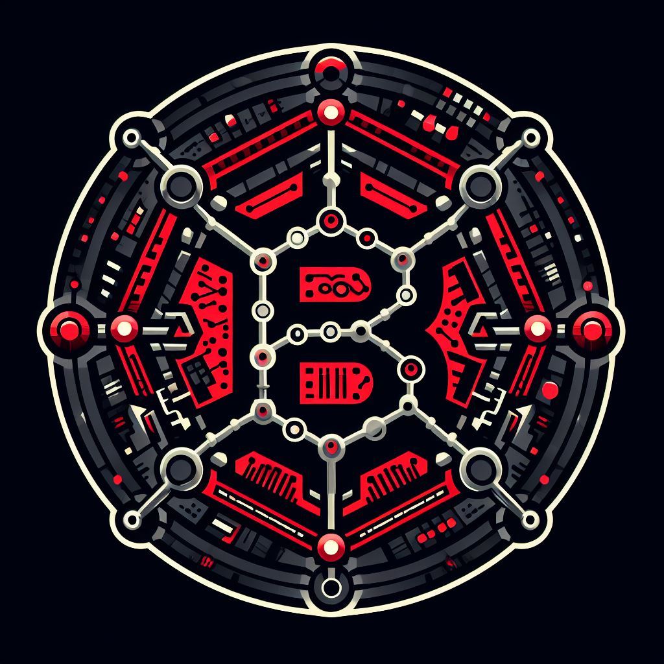

Blockchain Analytics with Spark, Kafka, and MongoDB – BIG DATA ARCHITECTURES – American college of Greece data science mS itc6107 Winter 2024
$$K−squared$$
ALKIVIADIS KARIOTIS MYRTO KONTI

Slide 2
AGENDA
problem description
SOLUTION Architecture
decisions DESIGN
running application (SCREENSHOTS)
Lessons learnt

Slide 3
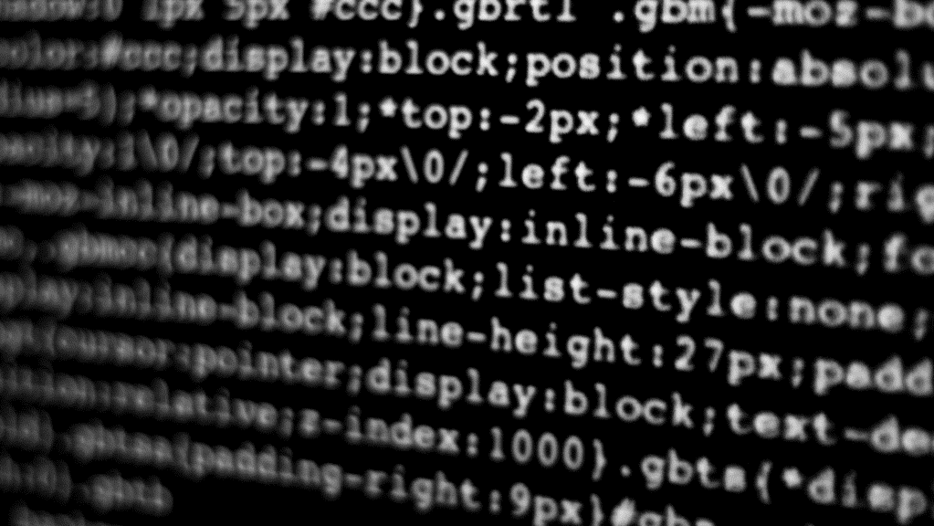
PROBLEM DESCRIPTION

Slide 4
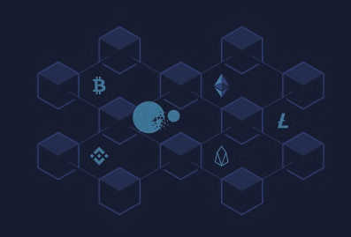
PROBLEM DESCRIPTION
Brief overview of blockchain technology
Challenges in implementing a blockchain system
Need for a distributed system to handle transactions and blocks effectively

Slide 5
SOLUTION ARCHITECTURE

Slide 6
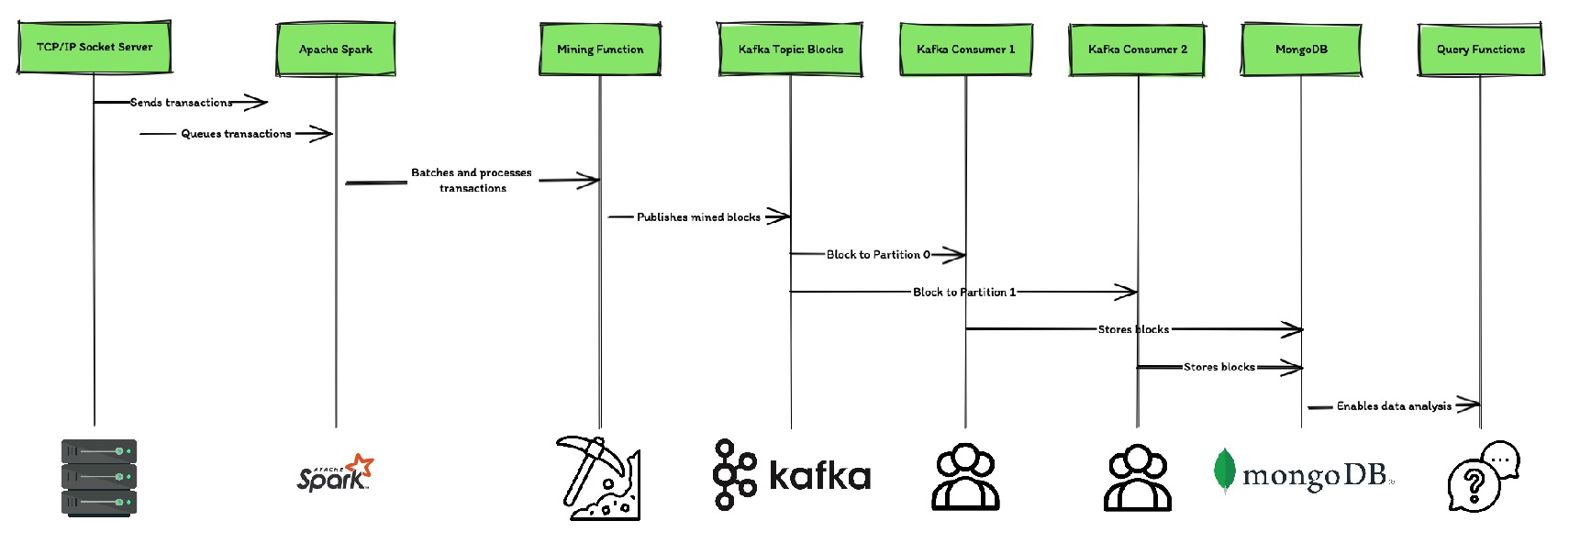
ARCHITECTURE DIAGRAM
ARCHITECTURE diagram

Slide 7
DESIGN DESICIONS

Slide 8
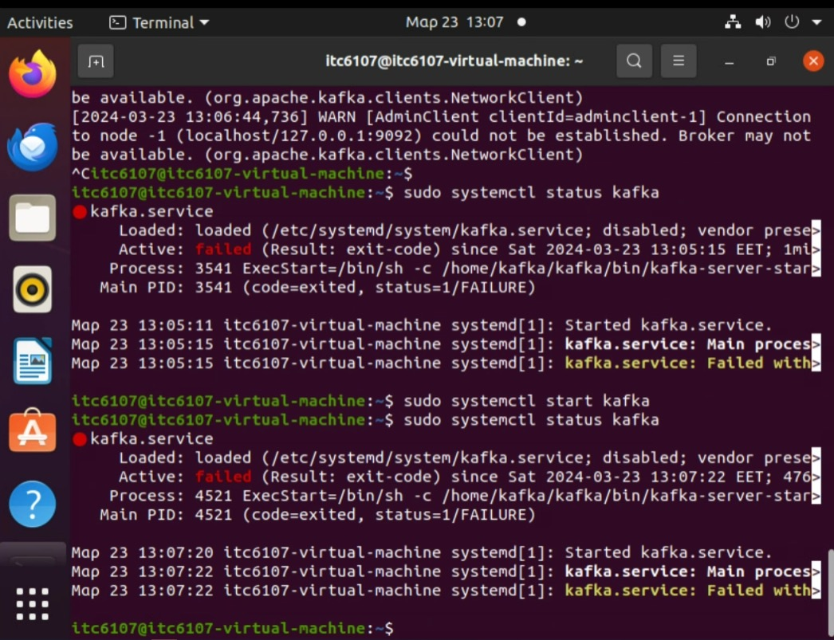
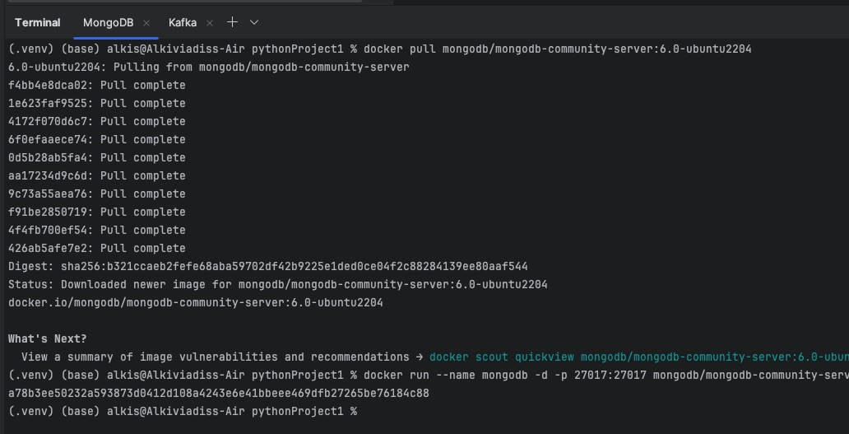
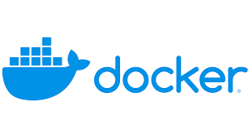
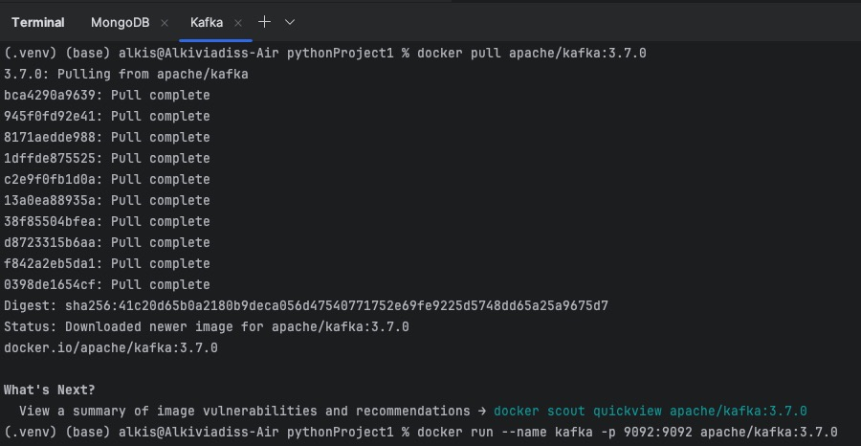

Virtual Machines error
SETTING UP Kafka & MongoDB In PyCharm with Docker

Slide 9
DESIGN DECISIONS
Producer
Overview of design decisions made during implementation
Use of Kafka for message transmission, to ensure reliability and fault tolerance
Producer
2 Partitions / 2 Consumers
Choice of MongoDB for storing blockchain data due to its flexibility and scalability
Kafka Cluster
Topic: Blocks
Partition 0
Partition 1
Consumer 0
Consumer 1

Slide 10
Running application

Slide 11
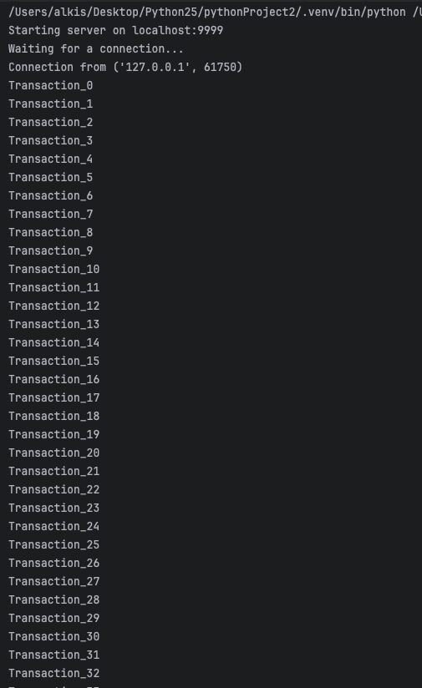
TRANSACTION SERVER
Displaying generated transactions and their transmission over the TCP socket
Description of the Transaction Server
Generates transactions and sends them over a TCP socket
Ensures continuous flow of transactions to the blockchain miner
Notes:
Server waits for connection until the miner is connected and begins to generate transactions.
Transactions generation continuous indefinitely unless the python scripts are interrupted.

Slide 12
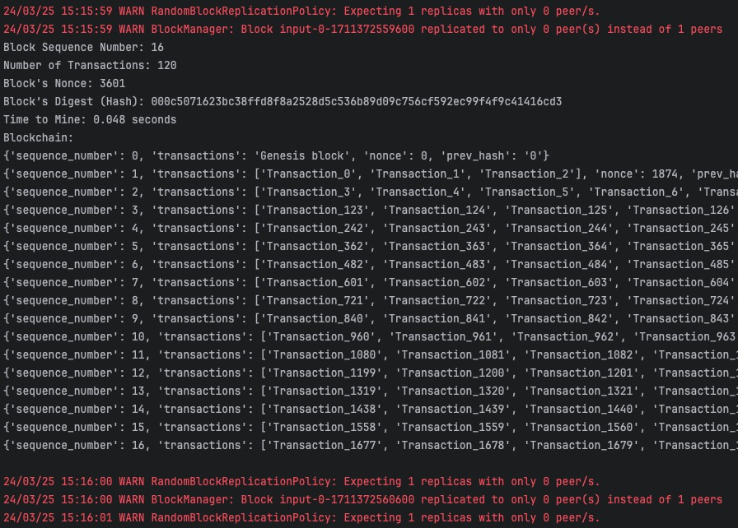
BLOCKCHAIN MINER
Displaying mining process and sending mined block information to Kafka topic "Blocks“
Message broker used for communication between components
Provides fault tolerance, scalability, and high throughput
Notes:
- Blockchain Miner
Prints a block every time one is mined
With the all-relevant information.
Sequence Number | Transactions | Nonce | Digest/Hash | Time it took to min
2 Minutes interval for each block mined.
The complete blockchain is printed including all blocks with their info mentioned and as the hash the previous block.

Slide 13
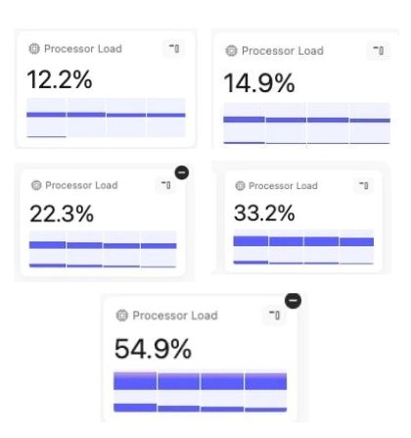
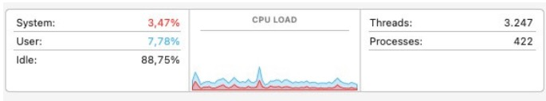
– Blockchain Miner –
Description of the Blockchain Miner
Mines blocks using Proof of Work
Sends mined block information to Kafka topic "Blocks"
Notes:
Right hand side graph we see the 8 processors selected by code to be used to mine blocks
At the beginning the processor load is lower and increases at the time of mining the block.
This is also highlighted by the spikes in the left side graph on CPU Load.

Slide 14
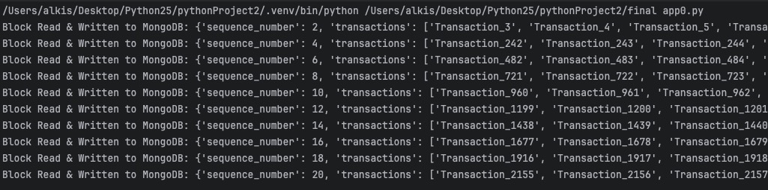
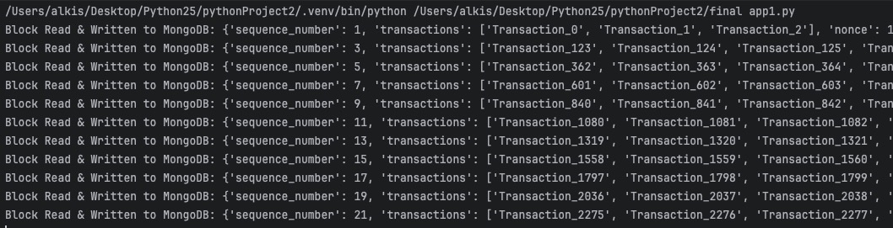
Saving Odd & Even Blocks to MongoDB
Reading the Blocks from the Kafka Topic: Blocks
Even Blocks from Partition 0 – Consumer 0
Odd Blocks from Partition 1 – Consumer 1
app0.py & app1.py write the blocks to MongoDB
Each app prints the blocks it contains upon the completion of block mining by mine.py
Notes:
Display of app0.py and app1.py printing the info of the blocks read from the Kafka Topic Blocks
And written to MongoDB.
The code has run for a significant amount of time
2 minutes intreval for each block we see.
Approximately 42 minutes for 21 blocks.
App0 reads and writes even, while app1 handles odd sequence number blocks.

Slide 15
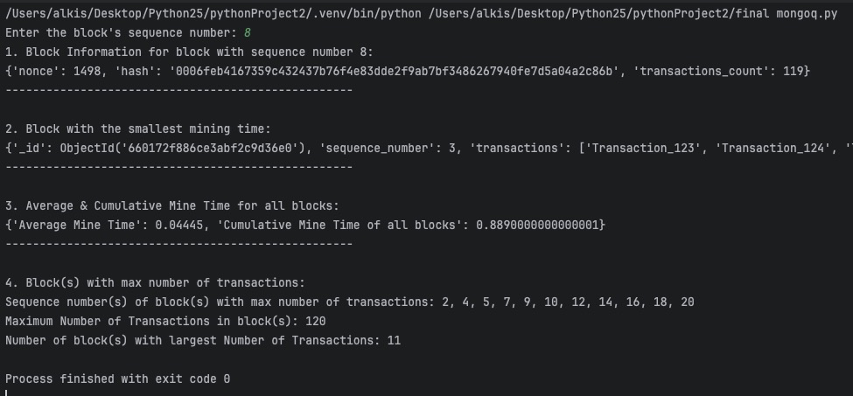
Query results from MongoDB
NoSQL database used for storing block information
Provides flexibility and scalability for managing blockchain data
Notes:
Query results from the info written to MongoDB
Specifically, we queried 4 questions.
Directly ask the user for a block sequence number and returned the information co0ntained in this block.
We found the block with the smallest time to mine
We calculated the average and cumulative mining time. Interestingly this returns different results when we re-run the mongo question code.
Returns the maximum number of transactions used to mine one or more blocks and returns the sequence numbers of those blocks and the count of these blocks.

Slide 16
Lessons learnt

Slide 17
LESSONS LEARNT
Integration Challenges and best practices in working with a network of multiple applications [Kafka, MongoDB]
Acknowledgement of assumptions made to complete the complex process of blockchain mining in a simplified version
Scalability considerations for handling large volumes of blockchain data.

Slide 18
Questions ?
Thank you

